Slide 1
COMET WAY RENTALS

Slide 2
Summary of the client’s issue
The company needs a centralized software application to manage tenant and operational data efficiently.
The system should allow tenants to update and retrieve information on occupancy rates, revenues, maintenance issues, and lease details.
The software should have real-time updates, remote access, and be secure.
Sarah needs to digitize data collection and reporting to streamline property management and communication with headquarters.

Slide 3
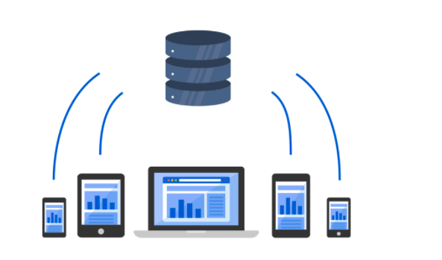
Solution Justification
Efficient property management and communication with Comet Way Rental’s headquarters requires a secure, centralized system with real-time updates and remote access.
A centralized system will improve overall performance, increase tenant satisfaction, and help the company to scale more effectively.

Slide 4
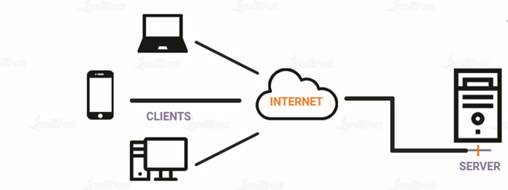
Client-Server Description
A Client-Server architecture with a web-based or mobile app client component and a cloud-based or on-premises server component is recommended for improved flexibility, scalability, and security in resolving the issue.

Slide 5
Solution Description
To address the problem, we will perform the below series of actions:
To determine the precise requirements for the new system, conduct a needs analysis.
Create the user interface, taking into account the required forms and reports.
Build the data entry forms and the database.
Develop the feature for creating reports.
Design the remote access function.
Conduct testing and debugging.
User education for the new system is required.

Slide 6
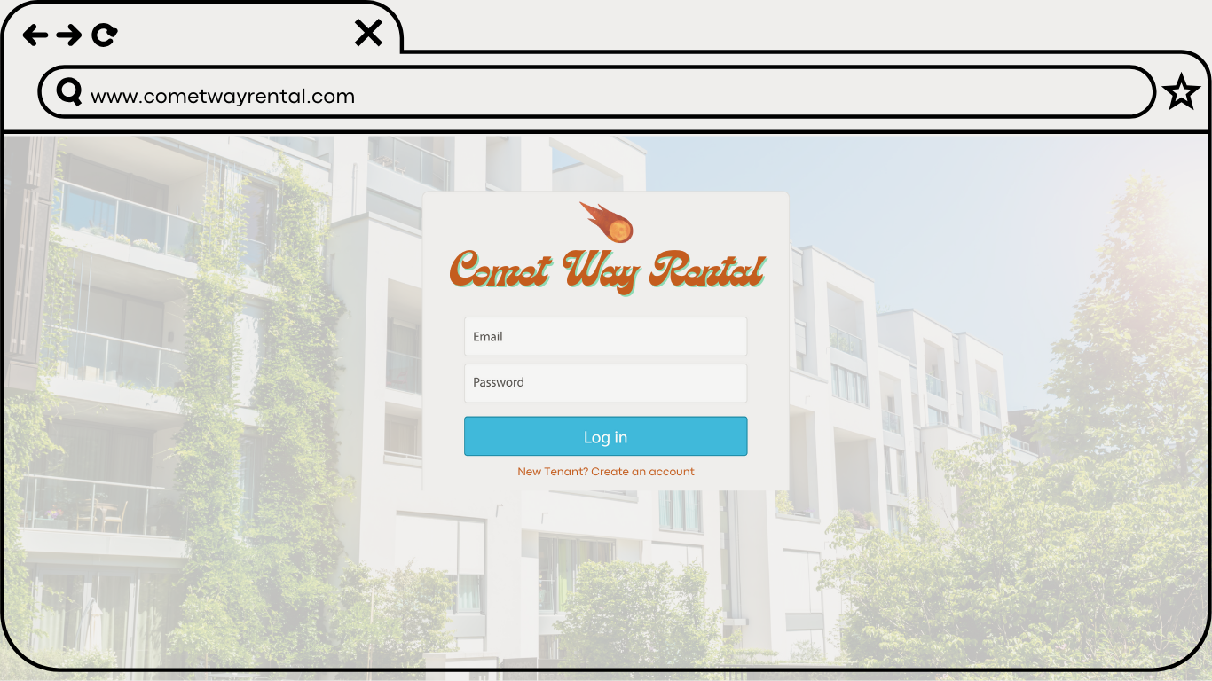
User Interface Design for Comet Way Rentals

Slide 7
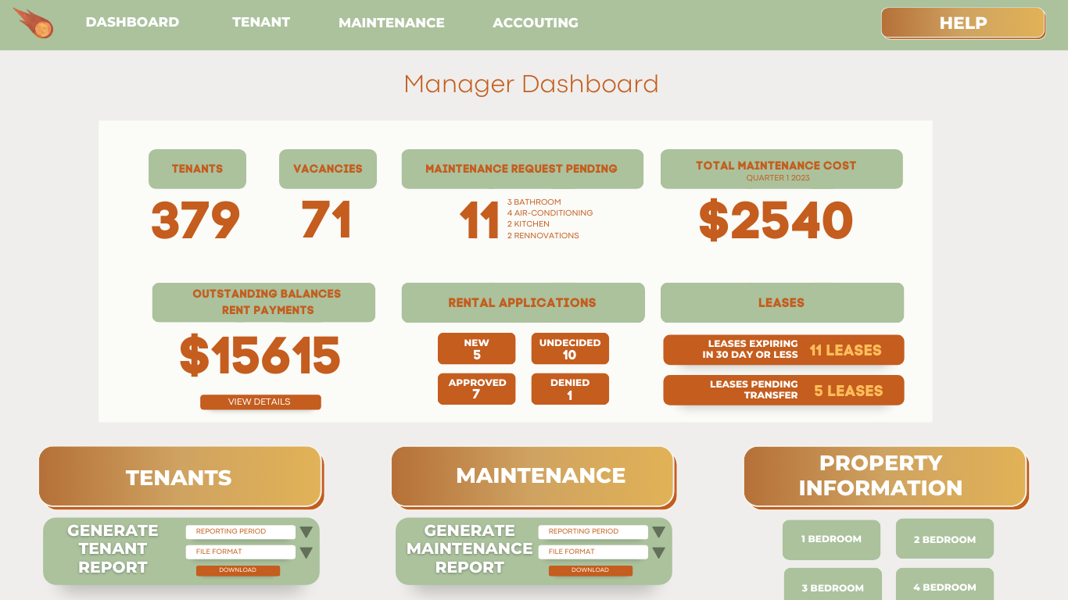
Manager Dashboard

Slide 8
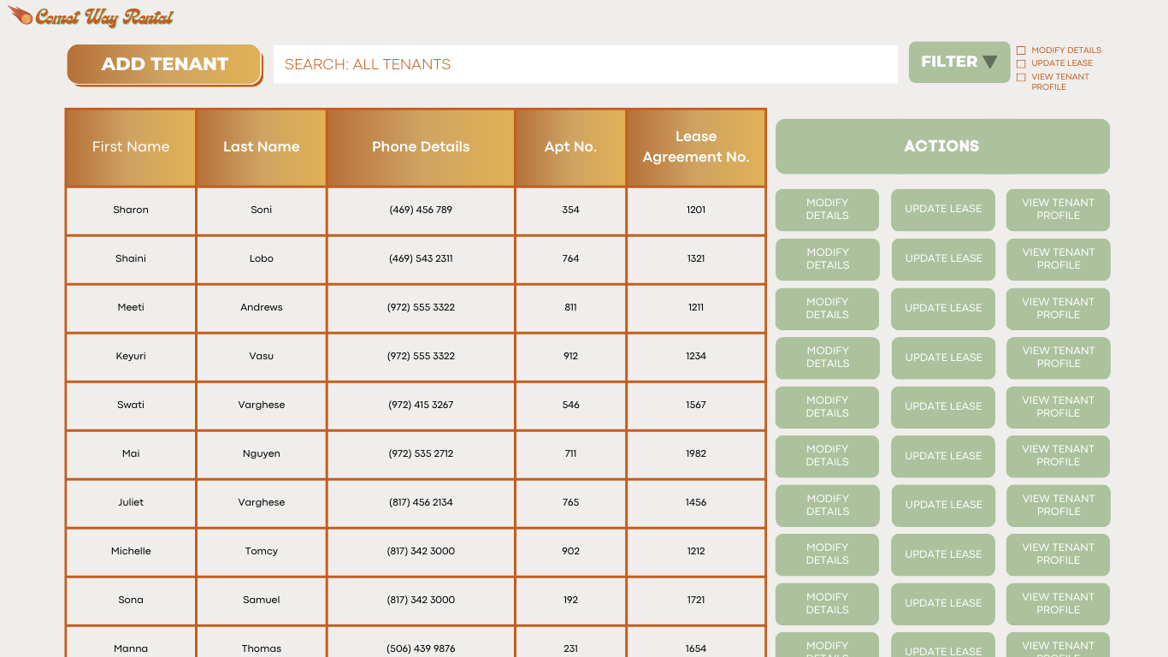
Displays all the details of tenants currently residing in the apartments based on move in date

Slide 9
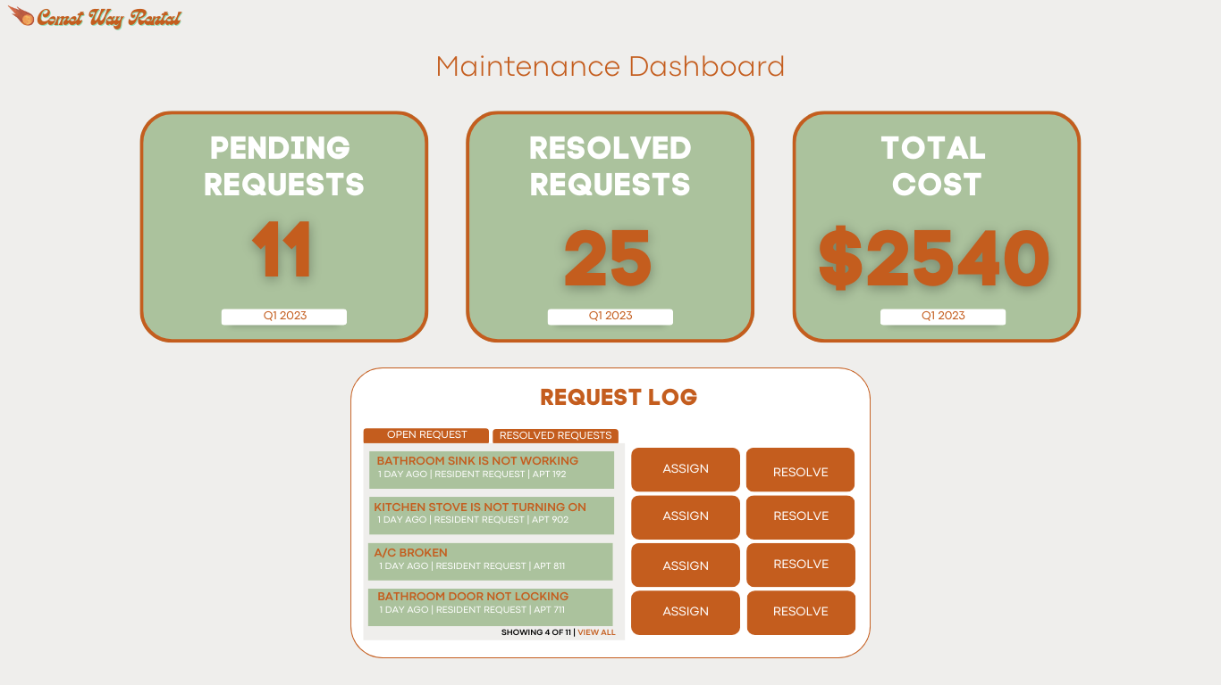
Maintenance Dashboard - Displays the pending requests, resolved requests and total cost, everything in the current quarter

Slide 10
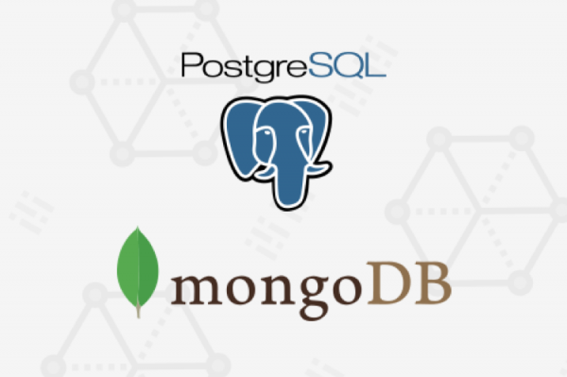
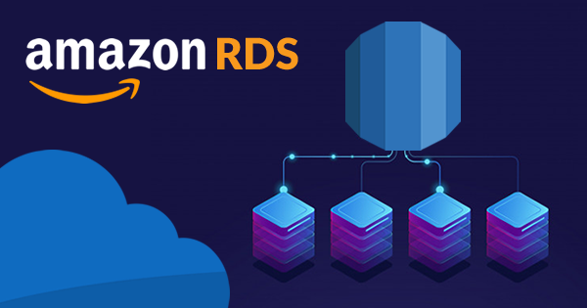
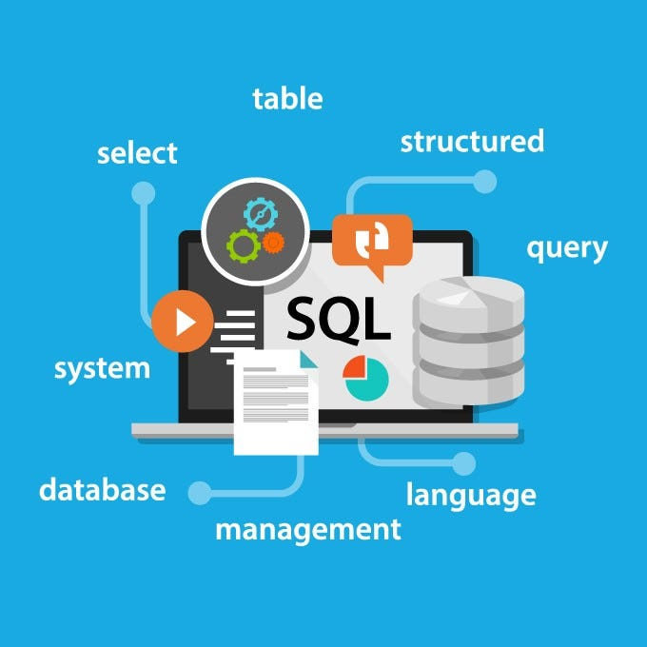
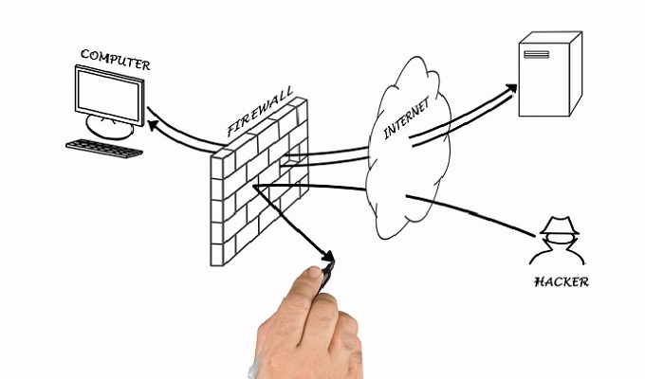
Preferred Platforms and Languages Used to store and maintain a data.
To develop cloud-based property management software, we would:

Slide 11
Design a data model and select a suitable database system like PostgreSQL or MongoDB
Create database tables, indexes, and constraints, and set up backup and recovery processes
Secure access to data using APIs, encryption, firewalls, and other security measures
Use AWS platforms like Amazon Aurora and RDS for scalable and cost-effective relational database.
Use SQL-based relational databases for structured data and NoSQL databases for unstructured data.

Slide 12
Estimated cost of solving the problem
Estimated Cost: $23,000 - $50,000
Hardware cost: Up to $5,000
Personnel cost: IT consultant, software vendor representative, and system administrator
Supporting web sources: Property management software solutions, IT consultant rates, system administrator rates, software vendor pricing structures.

Slide 13
Estimated time frame to complete each of the tasks listed
Tasks | Time Frame
Perform an assessment of requirements | June 1, 2023 to July 1, 2023
Design the user interface | July 1, 2023 to August 1, 2023
Develop data entry forms and the database | August 1, 2023 to September 1, 2023
Add functionality for creating reports | September 1, 2023 to October 1, 2023
Design the remote access function | October 1, 2023 to November 1, 2023
Conduct testing and debugging | November 1, 2023 to December 1, 2023
Training users on the effective use of the new system. | December 1, 2023 to January 1, 2024

Slide 14
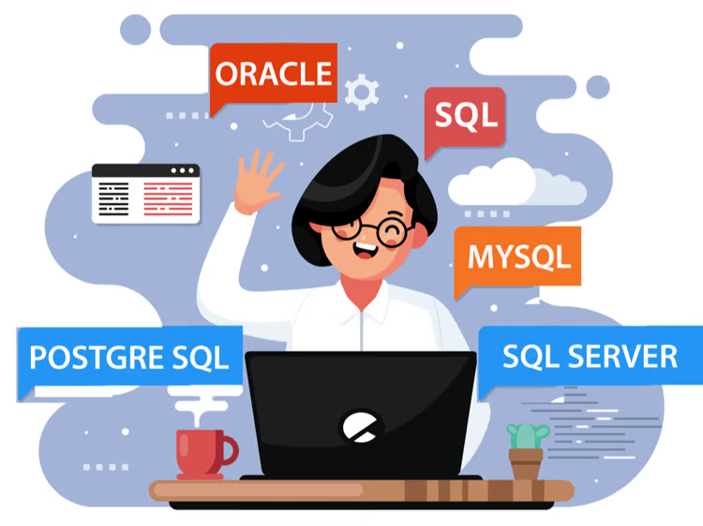
Thank You!!

